Slide 1
“iLearn@Home”
Barren County Non-traditional Learning plan

Slide 2
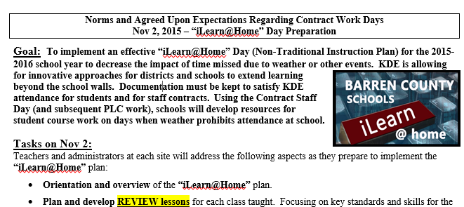
November 2, 2016 Initial Planning for Lesson Development
Set aside at least half of the day to work on “iLearn@Home development
Provide additional information about the plan and begin to develop –
Instructional Plans
Resources
Communication Plan

Slide 3
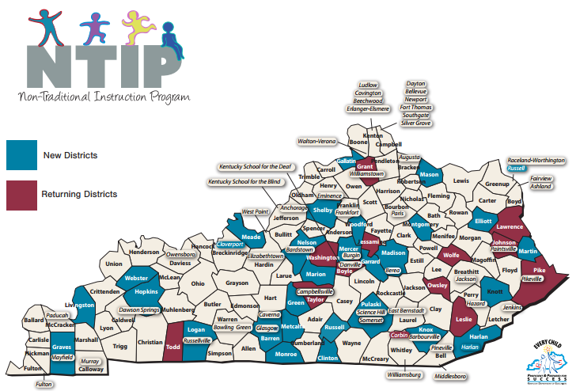
“iLearn@Home” Barren County Non-traditional Learning plan
For 2015-16, Barren County will be one of 44 school districts that look at instruction on snow days (or other days school would not be in session) differently. Under the provisions of the waiver, a district may count up to 10 non-traditional instruction days as regular attendance days in its school calendar and not have to make them up. Barren County Schools will likely never need all 10 days for non-traditional instruction, so our current plans are to prepare for approximately three days for 2nd semester of 2015-16, if needed. The plan allows for teachers and school/district leadership to develop opportunities for students to access course work both in print form and, if possible, in an online manner. The planned result is less loss of instructional time and increased ability to learn new content when school is back in session.

Slide 4
“iLearn@Home” Overview
PURPOSE
The main objective is to lessen the impact of missed instruction due to severe weather or other events that normally cause school to be cancelled. Students will be able to review previously taught concepts that will help to minimize instructional disruptions.
COMMUNICATIONS
Letters and other information will be sent home with each student detailing the school and teacher plans for content delivery and instruction. Additionally the information will share how students will be able to communicate with teachers on iLearn@home days.
PLANNING
Schools will set aside time to develop plans for implementation that include content, resources to be used, delivery method, and communication plans.

Slide 5
“iLearn@Home” Overview
CONTENT CREATION
Each school will build learning plans through on-going work within their PLC structure. Units of study will be developed as review and as reinforcement of previously-taught concepts. Grade-level teams and cross curriculum teams can provide support for development of rigorous learning experiences tied to Kentucky Academic Standards (KAS).
DIGITAL PRESENCE
In order for the non-traditional school days to be effective, teachers need maintain a digital presence throughout the school year. This will include teacher webpages, as well as another learning platforms. Additional tools like Remind 101, Edmodo, and Google Classroom can also be utilized.
STAFF CONTRACT OBLIGATIONS
Teachers shall be available during normal school hours (7:30-2:30/8:00-3:00) to answer questions and monitor online activity. Classified personnel will work with his/her supervisor in the creation of an alternate work plan.

Slide 6
Key Tasks for Nov 2nd Barren County Staff Contract Day
Teachers and administrators at each site will address the following aspects as they prepare to implement the “iLearn@Home” plan:
Orientation and overview of the “iLearn@Home” plan.
Plan and develop REVIEW lessons for each class taught. Focusing on key standards and skills for the course/subject that need further development and refinement.
Initial planning will be to create at least three lessons for each class so that enough work would be available for the first three days that “iLearn@Home” might be used.
Examples provided on district curriculum site.
Amount of student work would be equivalent to ½ the amount of class time (90 min block = 45 of classwork; 60 min class = 30 min; 50 min = 25 min; etc)
Develop method of delivering the material. Will it be paper-pencil task? Will you use on-line delivery – Edgenuity, Google Classroom, etc? Once developed, paper tasks can be scanned for electronic sharing. Remember materials protected by copyright cannot be posted on public websites.

Slide 7
Key Tasks for Nov 2nd Barren County Staff Contract Day
Teachers and administrators at each site will address the following aspects as they prepare to implement the “iLearn@Home” plan:
Discuss and begin to develop communication systems for parents and students. Develop methods to be in contact with families/students before the event, during the day, and after the “iLearn @ Home” day. Examples:
All teacher webpages should be updated to include an “iLearn@Home” link/page for easy access to class materials.
Discuss “teacher work” on “iLearn@Home” days and documentation to show: 1) Availability to students for classwork; 2) other teaching tasks completed (lesson planning, test development/scoring, program review documentation, website updates, etc); 3) Communication log. District collection system will be developed for additional documentation.
Before | During | After
Webpage | Webpage | Feedback on work
Letters home, school newsletters, etc. | Email, Remind 101 (texts) Phone, Google Classroom, etc | Surveys, parent meetings, SBDM Council discussions, etc

Slide 8
Key Tasks for Nov 2nd Barren County Staff Contract Day
Teachers and administrators at each site will address the following aspects as they prepare to implement the “iLearn@Home” plan:
Remember many teachers have already been doing similar work on snow days (reading work sent home; next lesson in math; AP work; etc)
Schools will report on the scope of the work from Nov 2nd and additional resources needed to complete the work. Google Form – “iLearn@Home Next Steps” – one submission per school
Answer the “questions to address” for planning to ensure the various aspects are covered in your plan.
Ultimate goal is for completion of all required components, materials prepped, and communication systems established prior to Christmas Break. With this completed, district will be prepare for implementation if needed beginning second semester.

Slide 9
Key timelines for “iLearn@Home”

Slide 10
Considerations for Consistency
Discussion for each level (ELEM, MIDDLE, HIGH)
Consistency within grade level and/or department
Grade level development of work
Department decision on all science at that level to have same lesson
Arts teacher working for across district work for students
Elementary considerations for consistency between schools
Idea of each school fully developing one lesson per subject per grade
Plans with resources submitted to district team to review/revise
Ability to publish work for all grades across district
Lessons the comparison of work between
Ensure tie to curriculum map
Builds on strengths of each site working together

Slide 11
Example & Resources
Sharing by CRTS of examples by level
Web resources posted
Vteam work focuses on developing and supporting communication platforms and other resources.
http://www.barren.kyschools.us/content/41160
http://barrencountyschoolselementary.weebly.com/sample-nti-days.html

